Slide 1







Prediction of Whether the client has subscribed to a term deposit or not
Application of Machine Learning
Get Started

Slide 2


01.
02.
03.
Objectives
Solution
Business Impact
content.
Table of

Slide 3


Objectives
This project aimed to predict whether the client (bank’s customer) has subscribed to a term deposit based on demographic attributes and effectiveness of marketing campaigns using Logistic regression model.

Slide 4
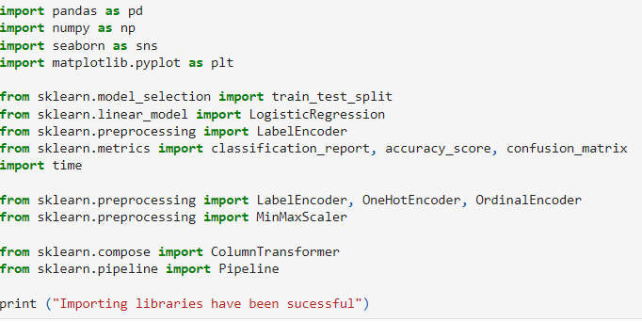
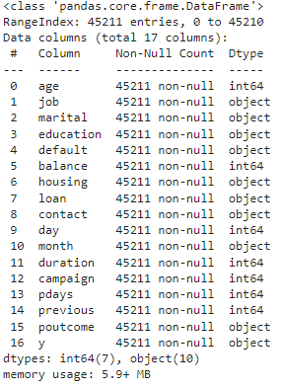
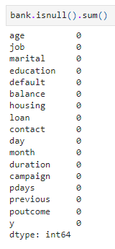
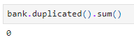
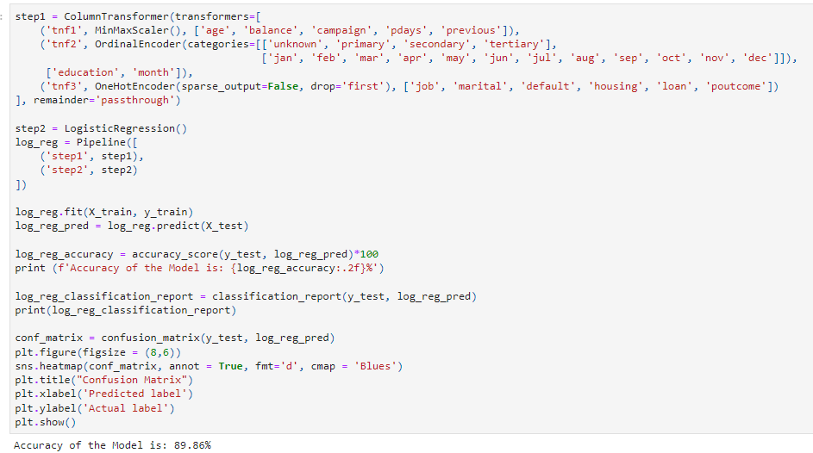
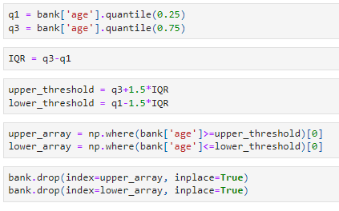
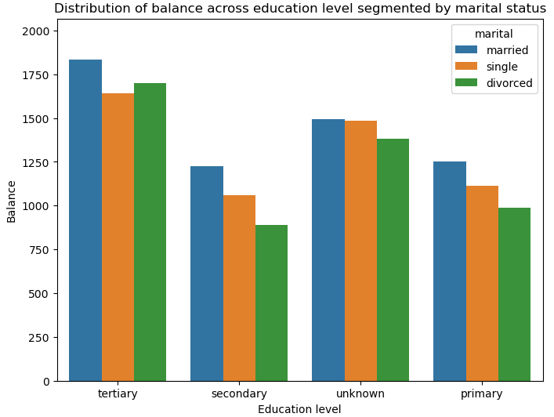
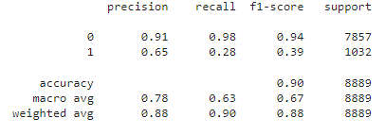
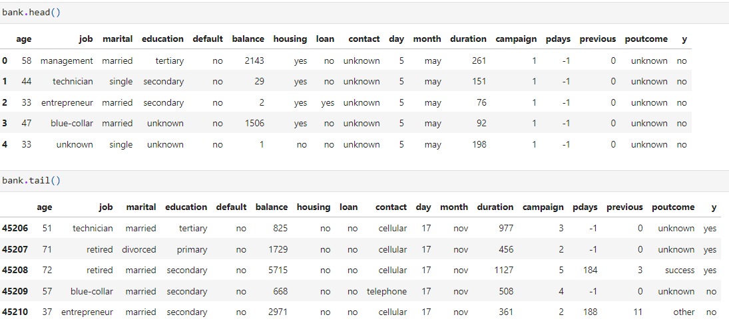
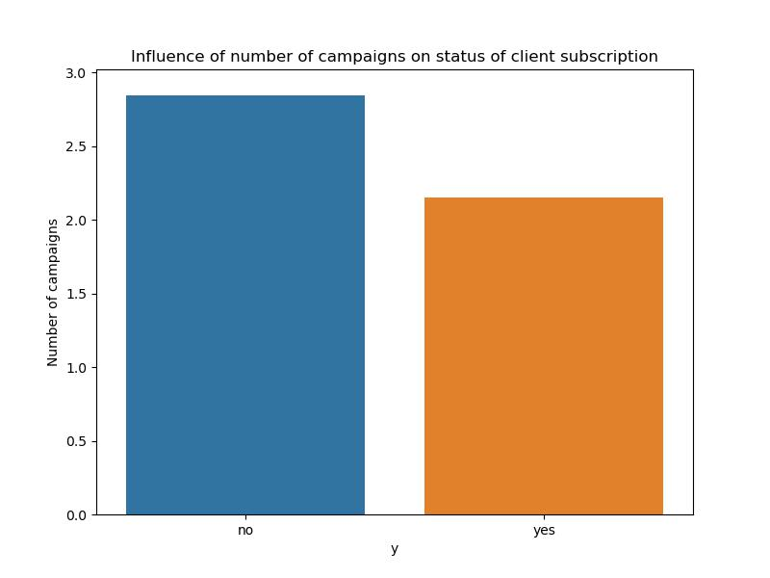
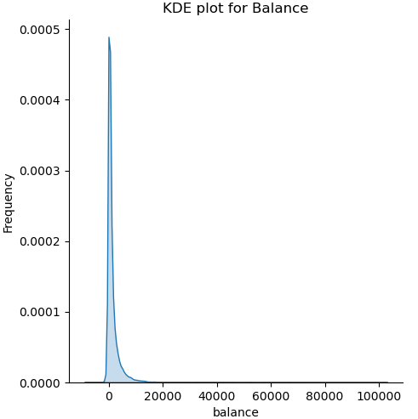
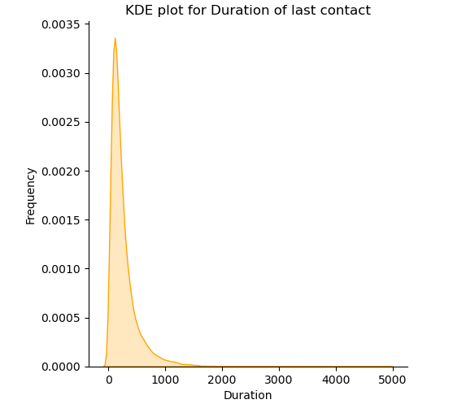
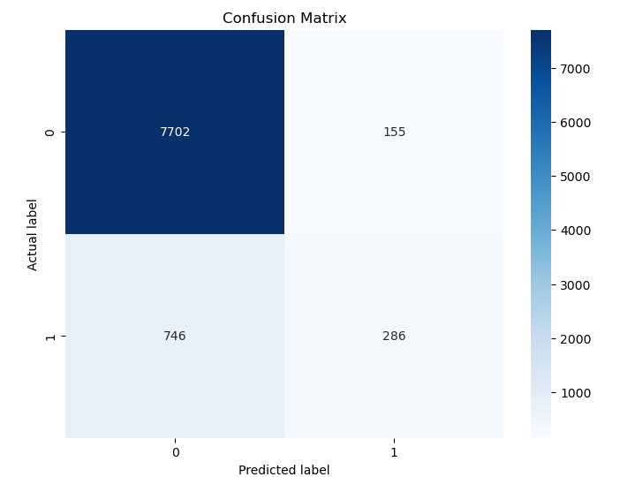
Solution
Libraries importing
Data Loading
Data Exploration
Data Preprocessing
EDA
Model development

Slide 5



Prediction of Subscription Status
Banking Managers can estimate subscription status of the clients.
Evaluation of Marketing effectiveness
Business Impact
Evaluation of effectiveness of marketing campaigns can be possible in the context of whether the marketing efforts have positive influenced subscription status of customers.
Customer demographics influence
Banking managers can estimate influence of customer demographic on their subscription buying intention

Slide 6

Thank
You.

